Slide 1
"Exploring Degrees, Diversity, and Control in U.S. Colleges"
"Exploring Degrees, Diversity, and Control in U.S. Colleges"
"Exploring Degrees, Diversity, and Control
In
U.S. Colleges"
Final Project

Slide 2
Data Cleaning
Initially we had 6807 rows and 1986 columns.
After cleaning the data we left with 5513 rows and 12 columns.
All the missing and null data were filtered out.
Remove invalid records.

Slide 3
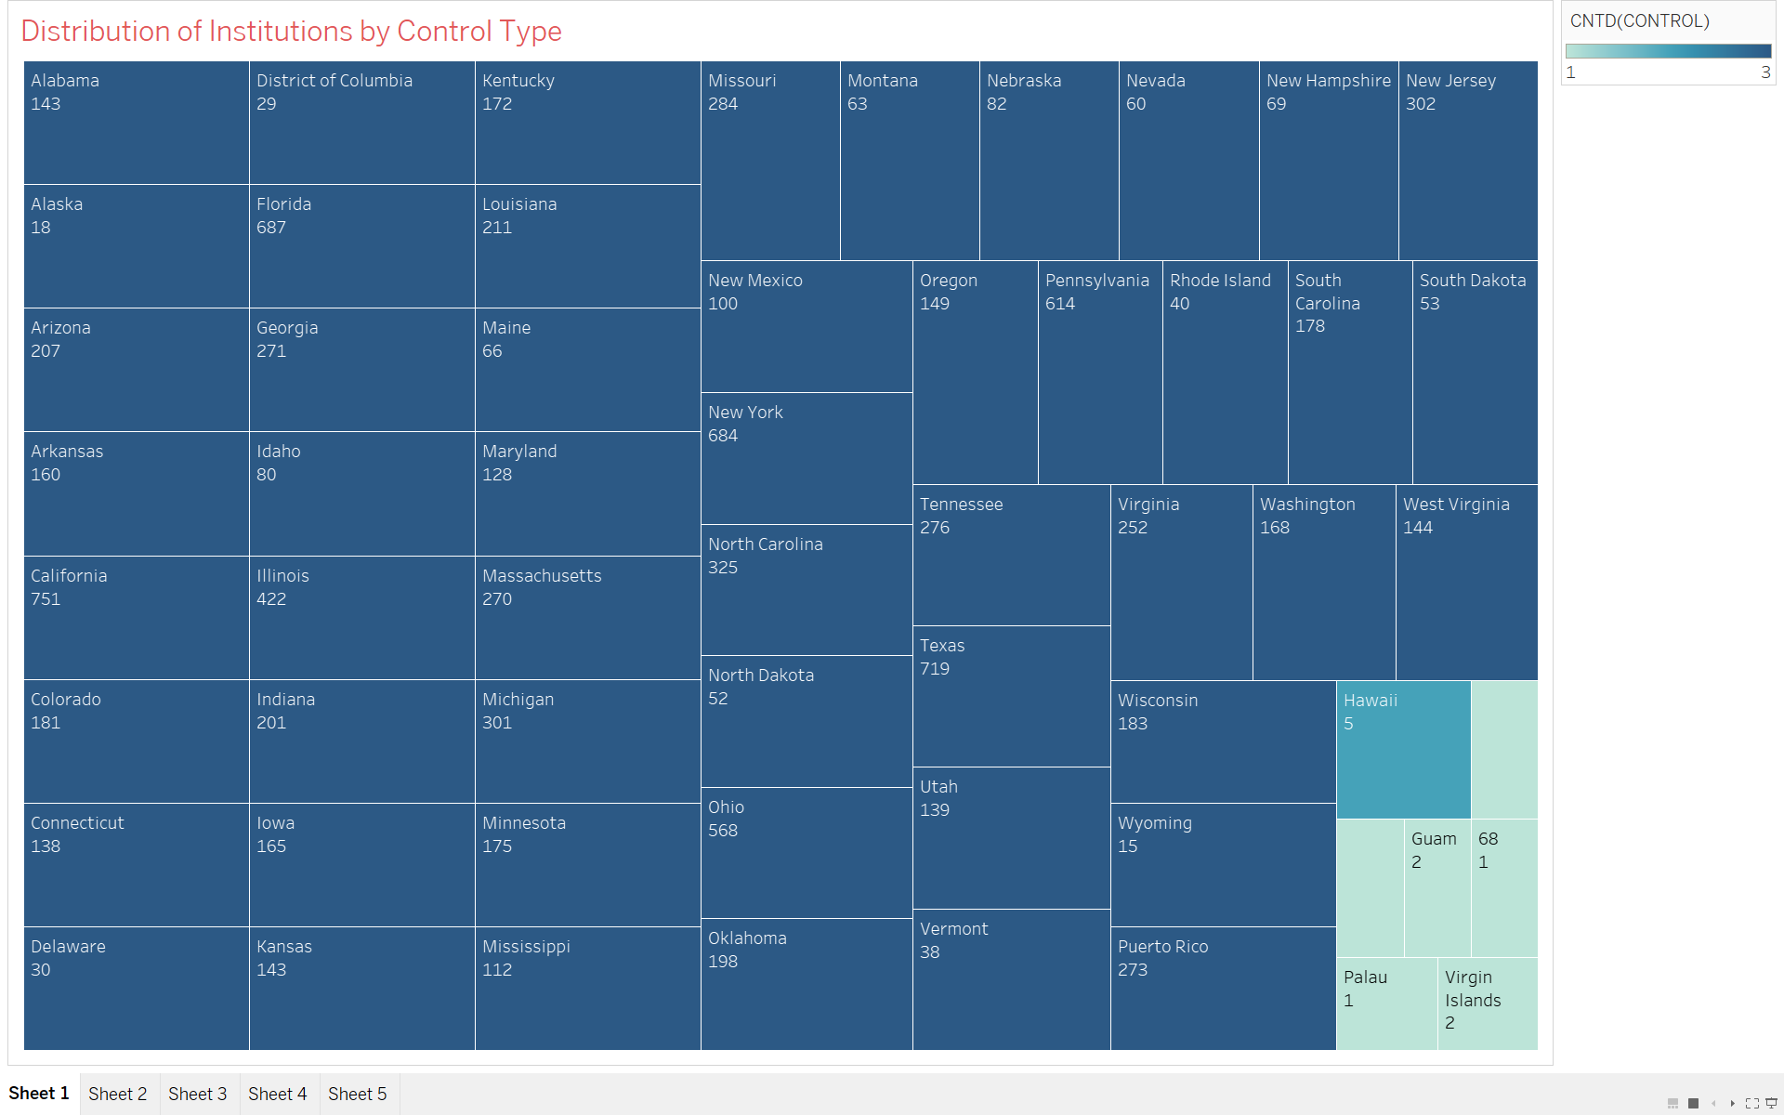
Visualization
Question 1: How are institutions distributed based on their control type (public, private nonprofit, private for-profit)?

Slide 4
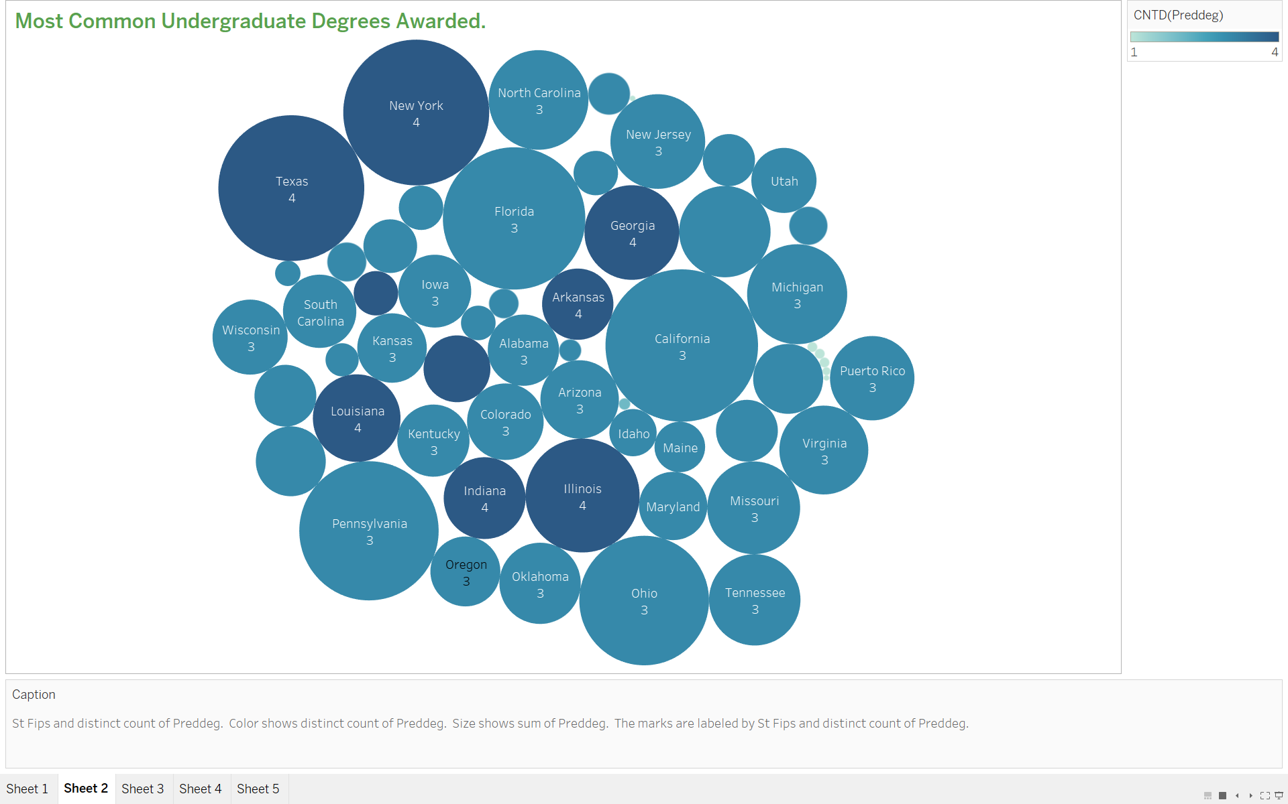
Question 2: What is the most common undergraduate degree type awarded across institutions?

Slide 5
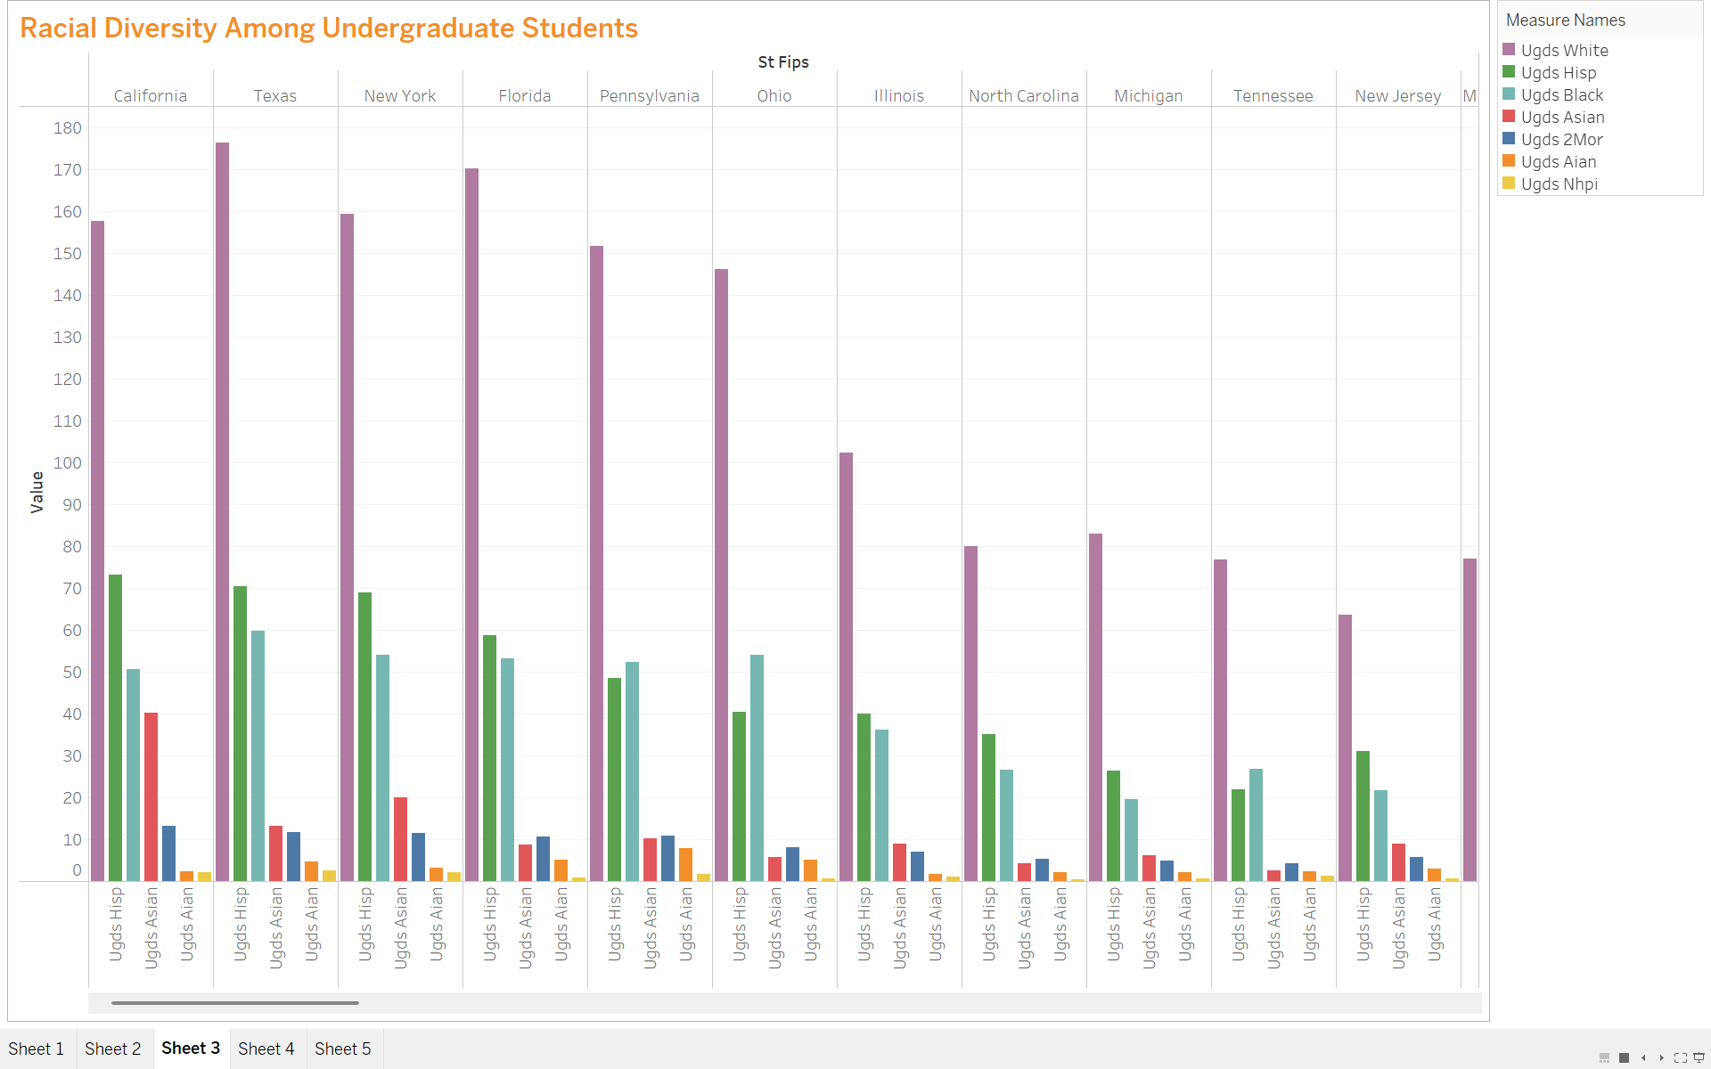
Question 3: What is the racial diversity among undergraduate students across all institutions?

Slide 6
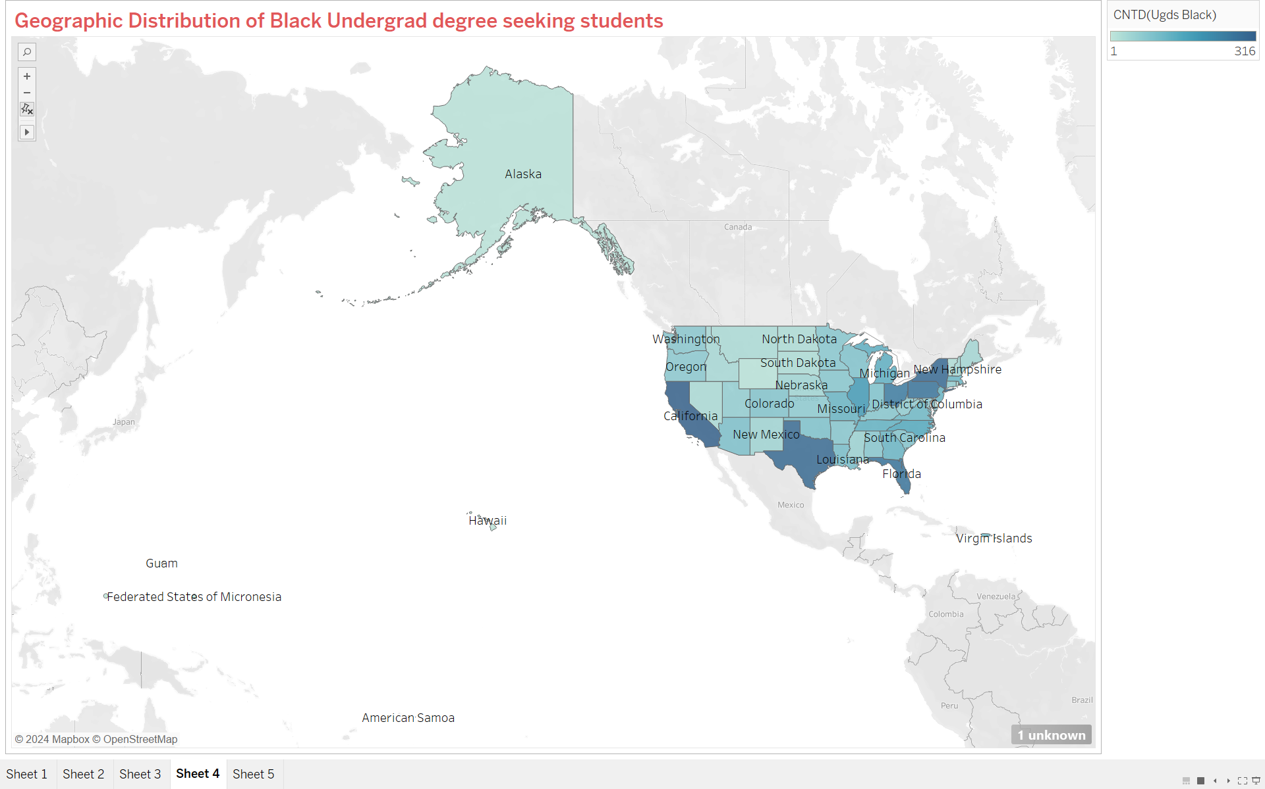
Question 4: How do the proportions of Black undergraduate students differ across public institutions?

Slide 7
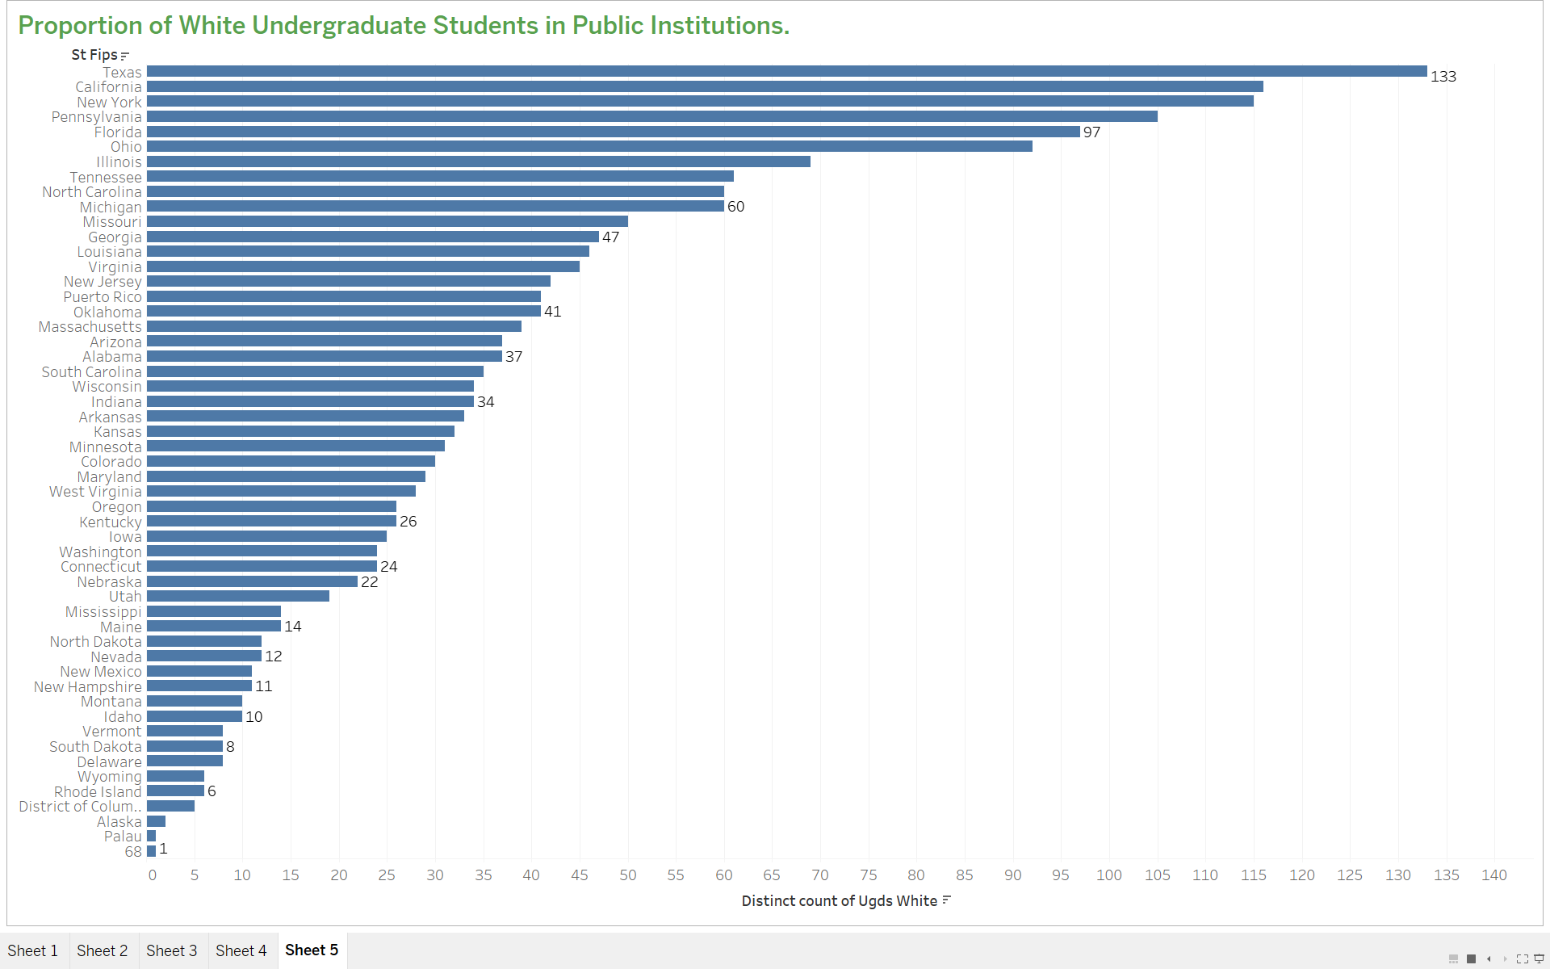
Question 5: How do the proportions of white undergraduate students differ across public institutions?

Slide 8
Conclusion
Visualizations make complex data easy to understand.
Patterns and trends become instantly clear.
They help communicate insights effectively.
Simplifies decision-making and storytelling.
Visualizations make complex data easy to understand.
Patterns and trends become instantly clear.
They help communicate insights effectively.
Simplifies decision-making and storytelling.
Visualizations make complex data easy to understand.
Patterns and trends become instantly clear.
They help communicate insights effectively.
Simplifies decision-making and storytelling.

Slide 9
Thank you
Aaditi Dharmendra Bhandari
St id- 11785848

